Slide 1
Location Based Advertising & Marketing System
Sappu Savari
I S Dewasurendra – 139160M
Supervised by: Mr. Saminda Premaratne
Faculty of Information Technology
University of Moratuwa

Slide 2
Agenda
Sappu Savari - Introduction
Background and Motivation
Aims and Objectives
Proposed System
Existing Issues in Systems
Technology Stack
Analysis and Design Consideration
Implementation
Conclusion

Slide 3
Sappu Savari - Introduction
Integrated Location Based Services.
Mainly targeted for smart mobile device users.
Most suitable for mid range sellers and buyers.
A native android mobile application and a web application.
System can be accessed by smart mobile devices and computers via Internet.
The Location would be gathered using Geolocation API (IP/GPS).

Slide 4
Sappu Savari - Introduction - Cont.
Users can post different types of information regarding their need (Buy/Sell items).
Users will be automatically notify when there are any suitable items available nearby.
Users can rate products, overall rating will calculate by the system.
Users can comment or give reviews.
Users can communicate by sending messages each other.

Slide 5
Background and Motivation
People are gradually moving to no paper concepts
Early ages people used to post advertisements in news papers.
People always interested in selling their old items rather than throwing away.
Several years back people sold their old lands and vehicles, but now mobile phones, TV, laptops, tabs, fans and more are being sold.

Slide 6
Background and Motivation – Cont.
Smart mobile device usage is higher than ever, and most of the time these devices is being used several times a day to access internet.
Lack of Location Based Services usage for marketing purposes.
Location Based Services are not available in Existing marketing systems.

Slide 7
Background and Motivation – Cont.
People spends much time to search relevant items to buy.
Need to browse every time to check the newly updated posts – not real time.
No reliable way to communicate between buyers and sellers.
Have to call or email.
Increasing frauds day by day.
Users sell broken items or stolen items – no way to rate or give reviews about the items to be sold.

Slide 8
Background and Motivation – Cont.
Have to call buyers/sellers and make appointments.
When the buyers meets the right product to buy, he/she have to call and make appointment to meet the buyer/seller and buy/sell the item.
Narrow opportunities and less chance to the buyers and sellers.
Buyers and sellers only focused to the near by areas, this narrow down the opportunities for business.

Slide 9
Aim and Objectives
The expected outcome of this research is to provide a comprehensive software system to support advertising and marketing.
For Seller,
Provide wider range buyers.
Better way to communicate with buyers.
For Buyer,
Automated search services will save lots of time.
Automated notification system.
Rating and provide reviews.
Minimize frauds.
Easy communication with sellers.

Slide 10
Aims and Objectives – Cont.
New features over existing services,
Automated search service to search newly added items automatically using buyer’s interest.
Integrated Geolocation services to notify buyers when there are interested seller is near by.
Provide route details to find the selected seller.
Opportunity to provide rating and reviews to minimize the frauds.
Better messaging services to communicate buyers/sellers.
Supports fully functional services in smart mobile devices and computers.

Slide 11
Proposed System
The system mainly using web protocols which means system functions as a web oriented system via internet.
Every user need to create an authentication to save and retrieve relevant information.
Uses geo location services on browsers to locate the users, so system can get the location even on IP based information(less accurate on IP based information and high accuracy when GPS is available)

Slide 12
Proposed System – Cont.
Sellers can post their product items or services which they planning to sell.
Buyers can search available items and services.
According to the searches system notify when there are new items are available.
Notify when interested sellers are near by.

Slide 13
Existing Issues in Systems
International,
Closs 5 – developed by Ebay. Integrated with Location Based Services to categorize the advertisements. Also provide online chat with other party.
Yardsale – developed by Apple corporation. Sellers can set a fixed location and those locations are listed down in a grid view on buyers mobile devices when searched.
Local,
Ikman.lk – can advertised over many product categories, location categorized.
HitLanka.lk – advertisements are categorized over product categories and location.

Slide 14
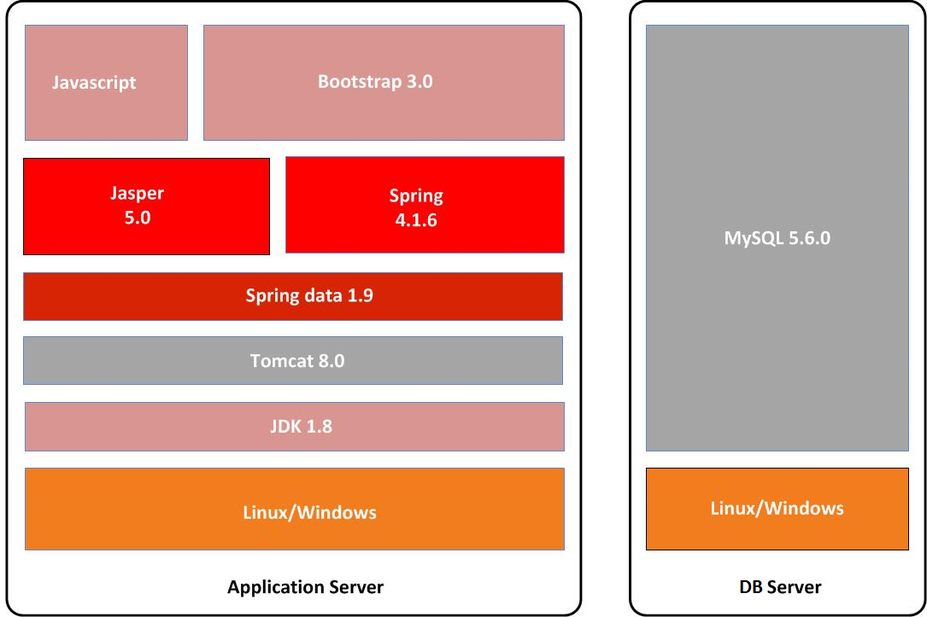
Technology Stack

Slide 15
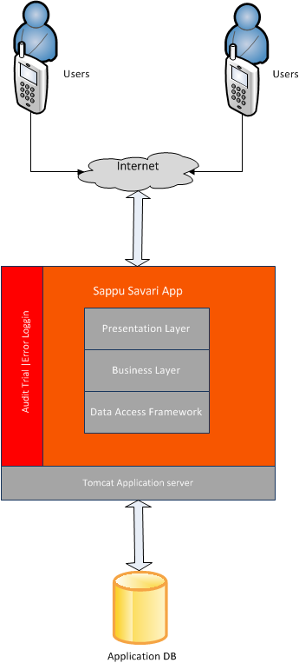
Analysis and Design Considerations

Slide 16
Analysis and Design Consideration – Cont.
UI Considerations
Model View Controller (MVC) Pattern – Spring framework front end controller.
Reusable Sorting for tables – Tables and list sorting will be controlled via JavaScript.
Internet Browser Support – The application will support Internet Explorer 9 and above/ Firefox 20 and above/ Google Chrome 28 and above. All UI features may not be supported in IE 6.0.
JQuery based AJAX framework
Bootstrap framework for support different size of screen sizes.
Segregate Look and Theme – The application will have CSS (cascaded style sheet) for storing font, color, table styles etc. This would certainly make the core application logic decoupled from application look and style.

Slide 17
Analysis and Design Consideration – Cont.
Data Model Design
The physical data model is done considering MySQL database.
The model has assumed soft deletion of entities compared to hard delete.
Uses of Design Pattern
Data access Object (DAO) pattern – Spring data - data layer
Factory Pattern – spring framework.
Singleton Pattern – database layer
MVC pattern – Presentation layer.

Slide 18
Analysis and Design Consideration – Cont.
Connection Pooling
Obtained by spring data framework.
Connection pool is used for obtaining database connections & those connections are released back to the pool after usage.
Transaction and Rollback
In case database exception occurs in DAO layer that will propagate up to Business layer and the transaction will be rolled back.
Concurrent Access
In “Sappu Savari” application, for use cases implementing mutex is not required.
Version column will be used on all tables to handle concurrent updates and to avoid data being overwritten from other sessions.

Slide 19
Analysis and Design Consideration – Cont.
Clustering Support
Business classes will generate single stateless instance in each JVM of clustering.
Logging Facilities
Log4j logging framework will be integrated to capture log into file system for any kind of operation in the system.
Audit Facilities
Every transaction table will have two audit columns namely “Created By”, “Created Date”, “Updated Date” – to track who has created/updated a particular entry in table and when that is happened.
Main transaction table consist with corresponding audit table to capture all the audit trail data for any modification of data in the main table.
Security
The application is accessible only through a valid login with necessary privileges.
https connectivity.

Slide 20
Implementation
Used open source technologies and development tools.
Eclipse
Mysql Workbench
Ireport
For the Data layer - MySQL database
Data layer implementation – Java
For further functionalities such as connection pooling, maintain scalability - Spring data JPA framework.
Business layer - Java and Spring framework.

Slide 21
Implementation – Cont.
The presentation layer will be developed using HTML5, JSP, JSTL, JQuery and BootStrap.
The presentation layer is capable of render user interfaces under range of screen resolutions to support multiple smart mobile devices.
Jasper reporting with Ireport- Report generations.

Slide 22
Conclusion
The newly proposed system will be well benefited to the people who spend a busy schedule in their life.
The time spending on browsing through the posted advertisements and allocate time and venue for meet and investigate will be saved.
Users notify automatically when the best matching seller or buyer comes nearby, so the user will be free of tension and stress of searching the proper buyer or seller to contact.
System notification will be included the contact details of the buyer or seller and shortest path details to find the other party.
Until you find the best matching seller or buyer the system will continue finding.

Slide 23
Conclusion – Cont.
Buyers can rank the sellers for future references which help other buyers to find better sellers.
The users need average computer literacy to use the system.
To experience the best of the system user will need a smart phone with internet connection and location facilities. Also internet connection and satellite signal for location facility need should be available and reliable to operate the system properly.
The whole system will need a high performance web servers and database servers to serve no of users at once. Also web servers will need a higher bandwidth network since huge amount of data needed to transfer between web server and clients.

Slide 24
Demonstration
isuru@gmail.com
Phone – Samsung Note3
kamal@gmail.com
Car - BMW X1 2011
ranjith@gmail.com

Slide 25
Demonstration
User creation/Profile
Sell Products/Services
Product Searching
Contact Seller
Search Requests
Auto Search Notifications
Seller Contact Buyer
Follow Product and Seller
Follow Seller in Google Map
Rate the Product
Comment/Review Product

Slide 26
Future Work
Functional
Add near by notifications
Add route information
Bug fixing
Non Functional
Make more user friendly
Increase performance

